Slide 1
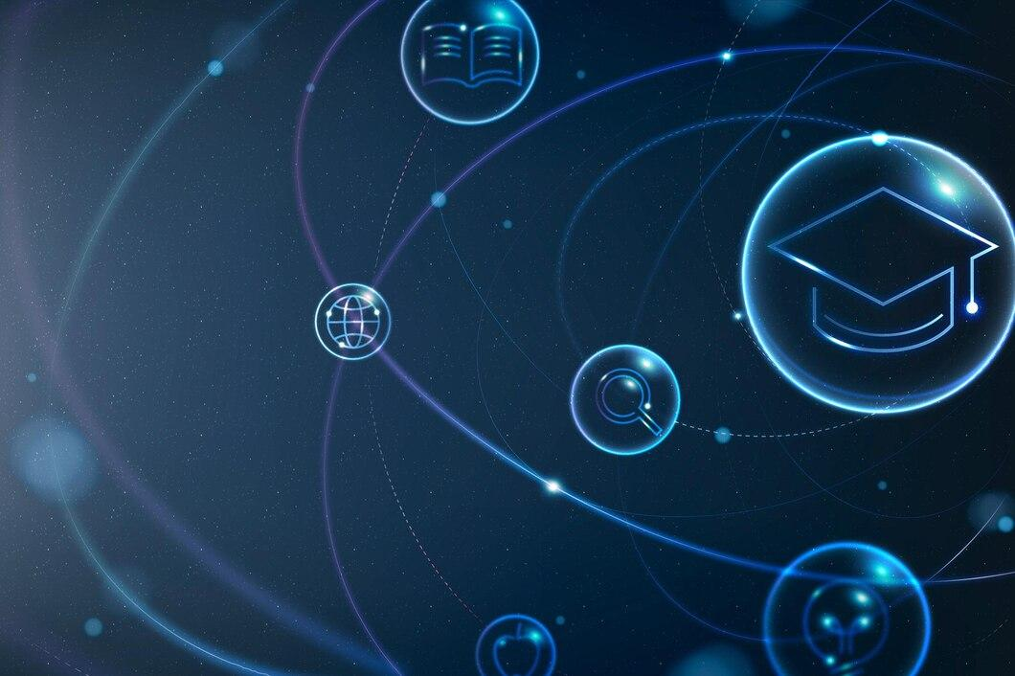
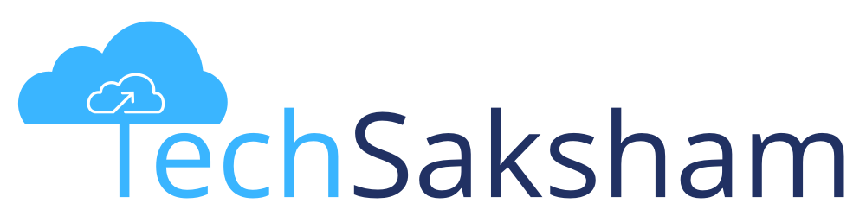




AI CHATBOT USING CHATGPT - OPEN AI API
Student Details
Name: BHARATHI A
NM Id: au2021107002
College Name: COLLEGE OF ENGINEERING GUINDY

Slide 2

Course Outline
AI CHATBOT USING CHATGPT - OPEN AI API
Abstract
Problem Statement
Aims, Objective & Proposed System/Solution
Project architecture
Algorithm
Future Scope
Conclusion
Reference

Slide 3

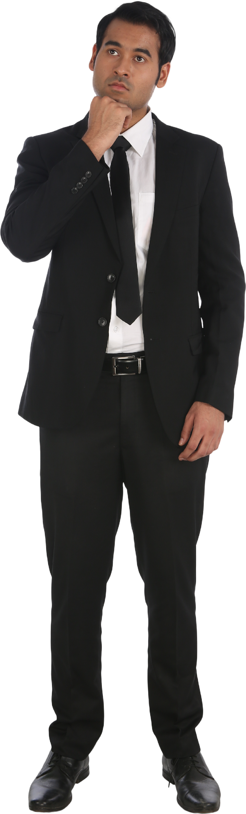
AI CHATBOT USING CHATGPT - OPEN AI API
Abstract
In today's digital era, artificial intelligence (AI) technologies are revolutionizing various aspects of human life. One such application is the development of AI chatbots, which leverage natural language processing (NLP) algorithms to interact with users in conversational manner.This project focuses on the creation of an AI chatbot using the ChatGPT model, powered by the OpenAI API. The key components of the project include setting up the OpenAI API, integrating the ChatGPT model into the chatbot system, and implementing a user-friendly interface for interaction

Slide 4


AI CHATBOT USING CHATGPT - OPEN AI API
Problem Statement
The problem addressed in this project is the design and implementation of an AI chatbot using the ChatGPT model, leveraging the OpenAI API. The goal is to create an intelligent virtual assistant capable of understanding user queries and generating contextually relevant responses in natural language.

Slide 5

AI CHATBOT USING CHATGPT - OPEN AI API
Aim and Objective
Aim: The primary objective of this Final Seminar is to present the outcomes and advancements made in the project “.AI Chatbot using chatgpt - open AI API” “

Slide 6
AI CHATBOT USING CHATGPT - OPEN AI API
Objectives
Conversational Interface: To provide a conversational interface, allowing users to interact with it using natural language input.
Real-time Responses: to receive real-time responses to their queries, enabling seamless communication with the chatbot.
Natural Language Understanding: to understand and interpret user inputs accurately.
Contextual Understanding: to maintains context during conversations, allowing for more coherent and relevant responses based on previous interactions.

Slide 7
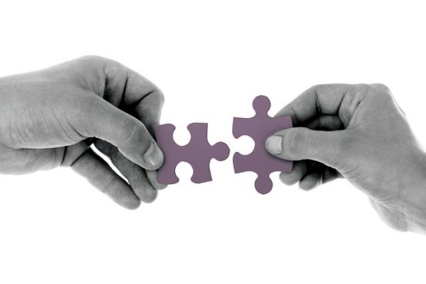
AI CHATBOT USING CHATGPT - OPEN AI API
Proposed Solution
The project aims to develop an AI chatbot leveraging the state-of-the-art natural language processing capabilities of the ChatGPT model through the OpenAI API. This chatbot will serve as an intelligent conversational agent capable of understanding user queries and generating human-like responses in real-time. The proposed solution seeks to address the growing demand for AI-powered virtual assistants across various industries, including customer service, education, and healthcare..
Notes:
‹#›

Slide 8
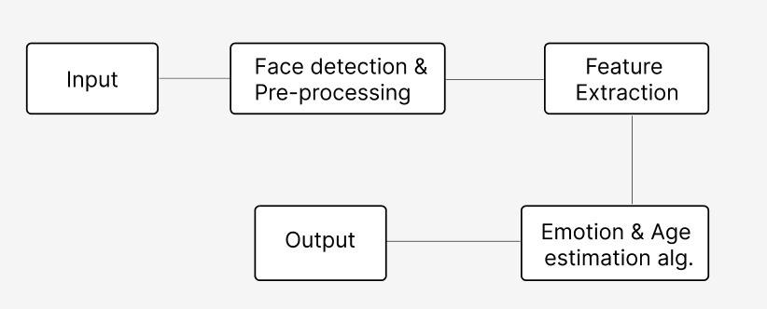
AI CHATBOT USING CHATGPT - OPEN AI API
Project architecture
API Key Authentication
request processing
response generation
Notes:
‹#›

Slide 9
AI CHATBOT USING CHATGPT - OPEN AI API
Algorithm
pip install openai
import openai
openai.api_key = 'your_openai_api_key'
def chat_with_gpt(prompt):
response = openai.Completion.create(
engine="text-davinci-003",
prompt=prompt,
max_tokens=50
)
return response.choices[0].text.strip()
Notes:
‹#›

Slide 10
AI CHATBOT USING CHATGPT - OPEN AI API
def main():
print("AI Chatbot: Hello! How can I assist you today?")
while True:
user_input = input("You: ")
if user_input.lower() in ['exit', 'quit', 'bye']:
print("AI Chatbot: Goodbye! Have a great day!")
break
prompt = f"You: {user_input}\nAI Chatbot:"
response = chat_with_gpt(prompt)
print(response)
if __name__ == "__main__":
main()
Notes:
‹#›

Slide 11
AI CHATBOT USING CHATGPT - OPEN AI API
Result
AI Chatbot: Hello! How can I assist you today?
You: What's the weather like today?
AI Chatbot: The weather today is expected to be sunny with a high of 75°F.
You: Could you recommend a good movie to watch?
AI Chatbot: Sure! How about "Inception"? It's a mind-bending thriller directed by Christopher Nolan.
You: Exit
AI Chatbot: Goodbye! Have a great day!
Notes:
‹#›

Slide 12
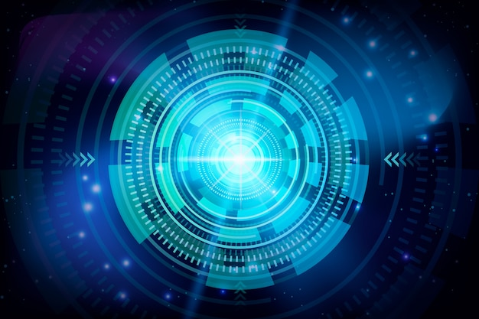
AI CHATBOT USING CHATGPT - OPEN AI API
Future Scope
The future scope for the AI Chatbot using OpenAI's GPT-3.5 API is promising, with several avenues for enhancement and expansion.Integration with natural language understanding (NLU) models could enable the chatbot to comprehend and respond to user queries more accurately and contextually.
Furthermore, extending the chatbot's functionality to support multi-turn conversations, personalized recommendations, and task-oriented interactions would enhance its utility in various domains such as customer support, education, and healthcare
Notes:
‹#›

Slide 13
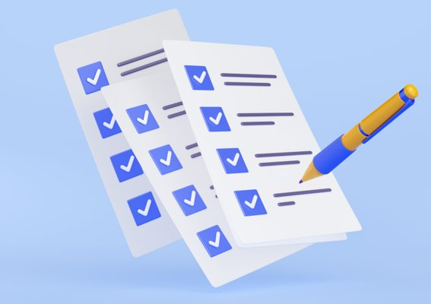
AI CHATBOT USING CHATGPT - OPEN AI API
Conclusion
In conclusion, the development of an AI Chatbot using the ChatGPT model through the OpenAI API offers a glimpse into the potential of natural language processing technology. By leveraging the power of GPT-3.5, we've created a conversational agent capable of understanding and generating human-like responses based on user input.
Throughout this project, we explored the steps involved in setting up the chatbot, including installing the necessary libraries, configuring the OpenAI API key, and defining functions to interact with the model.
Notes:
‹#›

Slide 14
AI CHATBOT USING CHATGPT - OPEN AI API
Reference
https://www.researchgate.net/publication/371616234_Aisha_A_Custom_AI_Library_Chatbot_Using_the_ChatGPT_API
https://www.researchgate.net/publication/373827610_Using_AI_Based_Chatbot_ChatGPT_for_Practicing_Counseling_Skills_through_Role-play
https://www.researchgate.net/publication/372572580_The_Ethical_Implications_of_ChatGPT_AI_Chatbot_A_Review
Notes:
Reference
These are the references for this session.

Slide 15
AI CHATBOT USING CHATGPT - OPEN AI API
Thank you!
Notes:
‹#›

